Slide 1
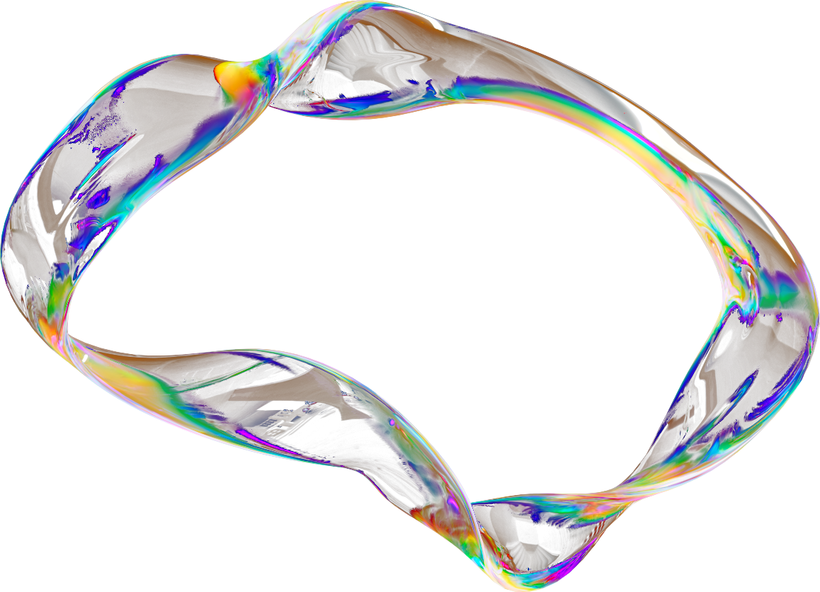


Presented by Rashi
CUSTOMER CHURN PREDICTION USING MACHINE LEARNING
rashirajaura0603@gmail.com

Slide 2


Identify High-Risk Customers
Calculated churn probability scores to identify customers with a high likelihood of leaving.
Ranked customers based on predicted risk to enable targeted business intervention.
Support Retention Strategies
Analyzed key churn-driving features such as contract type, tenure, and monthly charges.
Provided data-backed insights to design personalized retention offers and loyalty programs.
PROBLEM STATEMENT
Reduce Revenue Loss
Predict Customer Churn (Binary Classification)
Enabled early detection of potential churners to prevent customer attrition.
Helped improve customer lifetime value (CLV) by supporting proactive retention decisions.

Slide 3


DATASET OVERVIEW
Telco Customer Churn Dataset (~7,000 customers)
–Demographics & subscription details
–Billing & payment information
–Target Variable: Churn
Link to the dataset:
https://l1nq.com/6m3j3

Slide 4
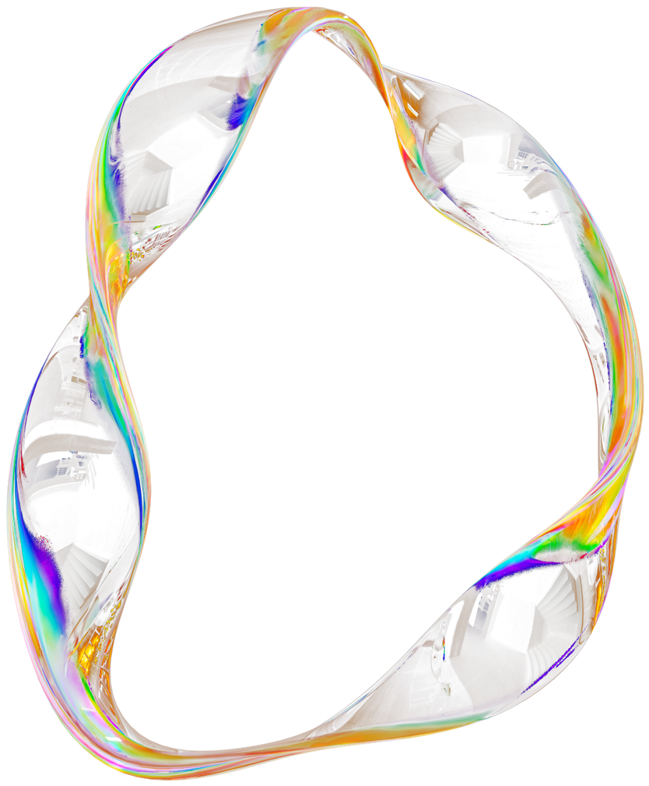
DATA PREPROCESSING
Removed irrelevant columns
Handled missing values
Converted TotalCharges to numeric
Applied One-Hot Encoding
Performed Stratified Train-Test Split
Feature Scaling using StandardScaler

Slide 5
HANDLING CLASS IMBALANCE
Observed Class Imbalance
The dataset contained significantly more non-churn customers than churn customers, which could bias the model toward predicting the majority class.
Applied Downsampling on Majority Class
Reduced the number of majority-class samples to match the minority class size, ensuring balanced class representation during training.
Balanced Dataset for Fair Learning
Created a balanced training dataset to prevent model bias and allow equal learning from both churn and non-churn cases.
Improved Minority Class Detection
Enhanced the model’s ability to correctly identify churners, leading to better recall and more effective churn prediction.

Slide 6
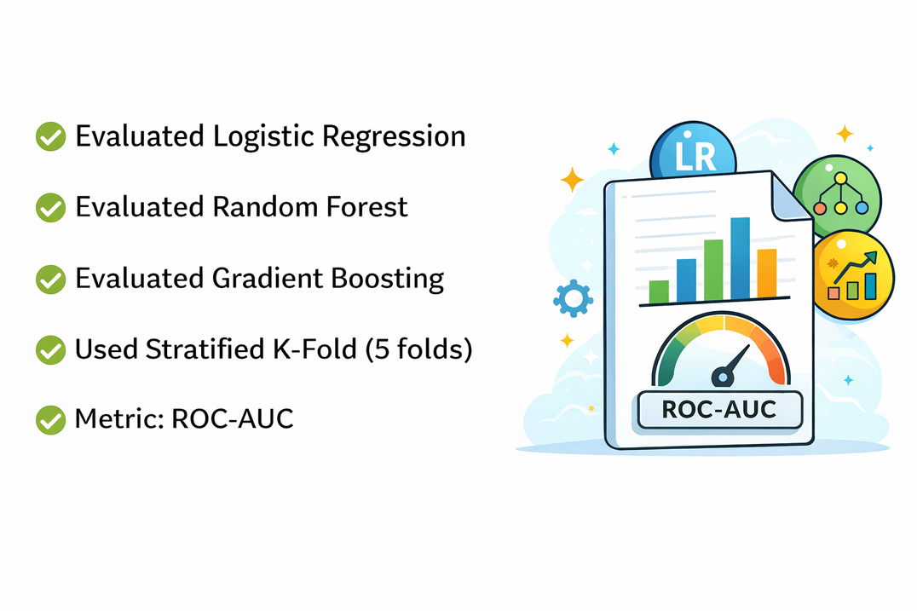
MODEL SELECTION
Evaluated Logistic Regression
Tested Logistic Regression as a baseline linear model to assess how well churn can be predicted using a simple and interpretable approach.
Evaluated Random Forest
Evaluated Gradient Boosting
Used Random Forest to capture non-linear relationships and feature interactions through an ensemble of decision trees.
Applied Gradient Boosting to sequentially improve weak learners and enhance predictive performance through boosting techniques.
Used Stratified K-Fold (5 folds)
Metric: ROC-AUC
Implemented 5-fold Stratified Cross-Validation to ensure consistent class distribution across folds and obtain reliable performance estimates.
Selected ROC-AUC as the evaluation metric to measure the model’s ability to distinguish between churn and non-churn customers across all thresholds.

Slide 7

HYPERPARAMETER TUNING
Applied RandomizedSearchCV:
RandomizedSearchCV was implemented to efficiently explore a wide range of hyperparameter combinations and identify the most optimal configuration for the model. This approach improves performance while reducing computational cost compared to exhaustive grid search.
Optimized n_estimators:
The number of estimators (trees) was tuned to balance bias and variance. Selecting an optimal number of trees enhances predictive accuracy without unnecessarily increasing model complexity.
Optimized learning_rate:
The learning rate was adjusted to control how quickly the model learns from errors during boosting. A well-optimized learning rate ensures stable convergence and prevents overfitting.
Optimized max_depth:
The maximum depth of trees was tuned to control model complexity. Proper depth selection helps capture meaningful patterns while avoiding overly complex models that may overfit the training data.
Improved generalization performance:
Through systematic hyperparameter optimization, the model achieved better generalization on unseen test data. This ensures reliable performance in real-world customer churn prediction scenarios.

Slide 8
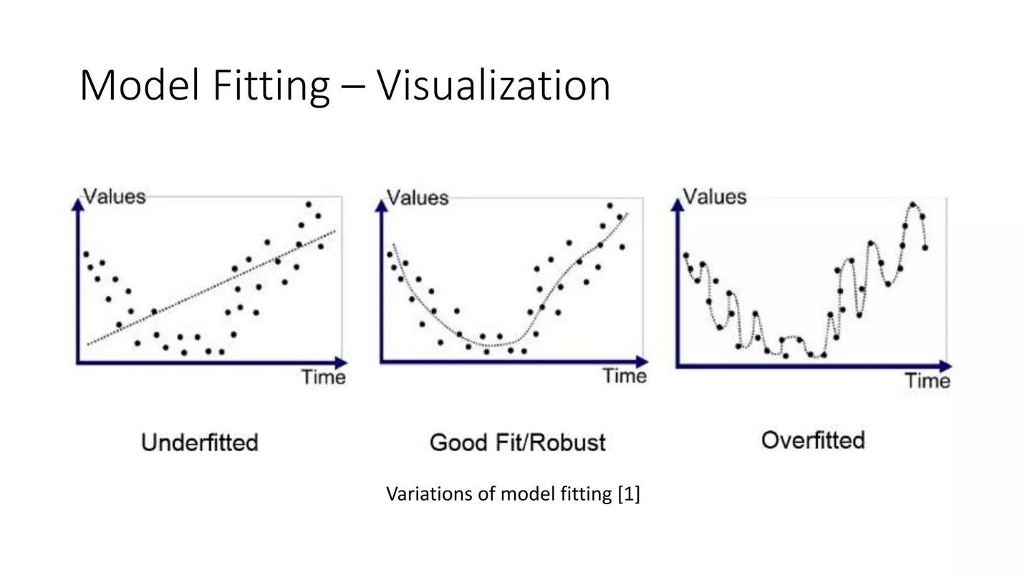
Overfitting Analysis
Compared Training vs Testing Accuracy:
Training and testing accuracies were compared to evaluate how well the model performs on both seen and unseen data.
Checked for Performance Gap:
Analyzed the difference between training and testing scores to detect potential overfitting or underfitting issues.
Model Generalizes Well:
Since the performance gap was minimal, the model demonstrates good generalization and maintains stable predictive accuracy on new data.

Slide 9

MODEL EVALUATION
ACCURACY SCORE
ROC-AUC SCORE
CONFUSION MATRIX
ROC-AUC evaluates the model’s ability to distinguish between churners and non-churners across all classification thresholds. A higher AUC (closer to 1) indicates better separability and stronger predictive performance.
The confusion matrix shows the number of True Positives, True Negatives, False Positives, and False Negatives. It provides a detailed breakdown of prediction errors and helps understand where the model is making mistakes.
PRECISION, RECALL, F1-SCORE
PR SUPPORT
Precision measures how many predicted churners were actually churners, while Recall measures how many actual churners were correctly identified. The F1-Score balances both precision and recall, making it especially useful for imbalanced classification problems.
Feature importance identifies which variables contribute most to predicting customer churn. This helps understand key business drivers such as contract type, tenure, or monthly charges and supports strategic decision-making.

Slide 10



KEY BUSINESS INSIGHTS
Month-to-month contracts show high churn
Customers on month-to-month contracts have greater flexibility to leave, resulting in a significantly higher churn probability compared to long-term contract customers.
High monthly charges increase churn risk:
Long tenure reduces churn probability:
Tech support reduces churn likelihood:
Customers paying higher monthly fees are more likely to switch providers due to perceived cost burden or availability of competitive alternatives.
Customers with longer tenure tend to develop loyalty and trust in the service, making them less likely to discontinue.
Customers who have access to technical support services are generally more satisfied, which lowers dissatisfaction-driven churn.

Slide 11
BUSINESS IMPACT
Enables proactive retention campaigns
Improves customer lifetime value
Protects recurring revenue
Supports data-driven decision making
The model identifies customers at high risk of churn before they leave, allowing the business to take timely preventive actions. This supports targeted offers, discounts, or engagement strategies to retain valuable customers.
By reducing churn, customers remain subscribed for longer periods, increasing their total lifetime contribution to revenue. Predictive insights help maximize long-term customer profitability.
Early churn prediction helps safeguard steady subscription-based income streams. Retaining customers ensures consistent cash flow and reduces acquisition costs for replacing lost customers.
The analysis provides actionable insights into key churn drivers, enabling strategic planning based on evidence rather than assumptions. This improves marketing, pricing, and service improvement decisions.

Slide 12
Final Model Performance & Evaluation
Final Test Performance:
The optimized model demonstrates strong predictive capability on unseen data.
Test Accuracy: 74.02%
ROC–AUC Score: 0.846
Training Accuracy: 77.99%
Testing Accuracy: 74.02%
The small gap between training and testing accuracy indicates good generalization with minimal overfitting.
Classification Performance (Churn = 1):
Precision: 0.51
Recall: 0.80
F1-Score: 0.62
The model effectively identifies churn customers (high recall), ensuring most high-risk customers are detected for retention strategies.
Confusion Matrix Summary:
[[743 292]
[ 74 300]]
Correctly identified 743 non-churn customers
Correctly identified 300 churn customers
Maintains balanced performance across classes
Key Model Strength:
A strong ROC-AUC of 0.846 indicates high discriminatory power between churn and non-churn customers, making the model reliable for real-world business deployment.

Slide 13
Presented by Rashi
CONCLUSION
This project successfully built a complete end-to-end machine learning workflow for customer churn prediction, covering data preprocessing, class imbalance handling, model selection, and hyperparameter tuning. Multiple models were evaluated using Stratified K-Fold cross-validation, and the best-performing model achieved strong predictive performance based on ROC-AUC and other evaluation metrics. The final optimized model generalizes well on unseen data and is structured in a scalable manner, making it deployment-ready for real-world churn prediction and business decision support.
rashirajaura0603@gmail.com

